Slide 1
ANOMALY DETECTION
Team 3
A.J. Miller
Smita Singh
Ajay Kumar Nadimpalli
Krithika Sangareddypeta

Slide 2
AGENDA
Fraud Overview
Model Summary
Performance Analysis

Slide 3

Introduction
We selected Topic 2, Anomaly Detection
The goal is to detect potentially fraudulent transactions by classifying transactions as either normal or anomalous

Slide 4
OVERVIEW

Slide 5
Fraud is an Anomaly
Anomaly – something that deviates from what is standard, normal or expected
By its nature, fraud is an anomaly.
As such, fraud should be identifiable as distinctly separate from normal transactional data.

Slide 6
Data Selection
Fraud characteristics should be similar across all transaction platforms.
We were able to find a dataset comprised of online payment data.

Slide 7
Data Overview
The dataset has 6.4mm rows and 10 columns
The dataset has the following features:
Step
Type
Amount
NameOrig
oldbalanceOrg
newbalanceOrg
nameDest
oldBalance Dest
isFraud –we are trying to predict this one
isFlaggedFraud

Slide 8
Features Defined
Step: represents a unit of time where 1 step equals 1 hour
type: type of online transaction
amount: the amount of the transaction
nameOrig: customer starting the transaction
oldbalanceOrg: balance before the transaction
newbalanceOrig: balance after the transaction
nameDest: recipient of the transaction
oldbalanceDest: initial balance of recipient before the transaction
newbalanceDest: the new balance of recipient after the transaction
isFraud: fraud transaction
isFlaggedFraud: Flagged fraud transaction

Slide 9
Original Data Characteristics
Original data contained 8,213 fraudulent transactions
In the original data set, of the 8,213 fraudulent transactions, only 16 were flagged as fraud
The initial process was a poor identifier of fraudulent transactions
Original percentage of flagged fraudulent transactions = 16/8213 aka 0.19%

Slide 10
Fraud Detection Strategy
Upsampling
Downsampling, and
SMOTE (Synthetic Minority Over-sampling Technique)
These are all techniques used in data preprocessing for handling imbalanced datasets.

Slide 11
Fraud Detection Strategy
Upsampling
Pros:
Increases the representation of the minority class in the dataset.
No data is lost during the process.
Cons:
May lead to overfitting as the same data points are being used multiple times.
Increased computational complexity and training time.

Slide 12
Fraud Detection Strategy
Downsampling
Pros:
Reduces the number of samples in the majority class, leading to a more balanced dataset.
Can help reduce the impact of noisy or irrelevant data.
Cons:
Loss of information as some data points from the majority class may be discarded.
May not be suitable for datasets with small sample sizes.

Slide 13
Fraud Detection Strategy
SMOTE
Pros:
Generates synthetic data for the minority class, which can help improve the classification accuracy.
Helps reduce overfitting by adding new and different data points to the minority class.
Cons:
Generated synthetic data may not accurately represent the true distribution of the minority class.
May not be suitable for datasets with high dimensionality.

Slide 14
Fraud Detection Strategy
Feature engineering
Pros:
1. Focuses a model with a more direct starting point
Cons:
2. Misidentification of relevant features can be problematic.

Slide 15
Fraud Detection Strategy
Conclusion
We selected a feature engineering model as fraudulent transactions should have similar features, and beginning with those features should be more efficient.

Slide 16
Engineered Features
Did the sender initiate any transaction: Here we are Checking Flag, If there is a difference between the balance of originator account then it can be understood that there is an initation.
Was more than expected amount or less than expected amount debited from the transaction at senders end: Here we are checking whether the expected amount to be deducted from the originator's account is significantly different from the original balance

Slide 17
Engineered Features
Did the receiver get amount : If oldbalance and amount equal to zero then it is definitely a fraud. So, let's create a flag column to store this data.
Did the receiver get amount : Here a lambda function is created to check if the reciever has recieved any amount or not. If the value in the "receiver_balance_change" column is 1, it means that the receiver got some amount, and if the value is 0, it means that the receiver did not get any amount.

Slide 18
Engineered Features
Did the receiver get credited by more or less amount: Here if the value in the "Expected_amount_more_or_less" column is 1, it means that the receiver is expected to be credited by more or less amount than the original balance by a significant amount, and if the value is 0, it means that the receiver is not expected to be credited by a significant amount.

Slide 19
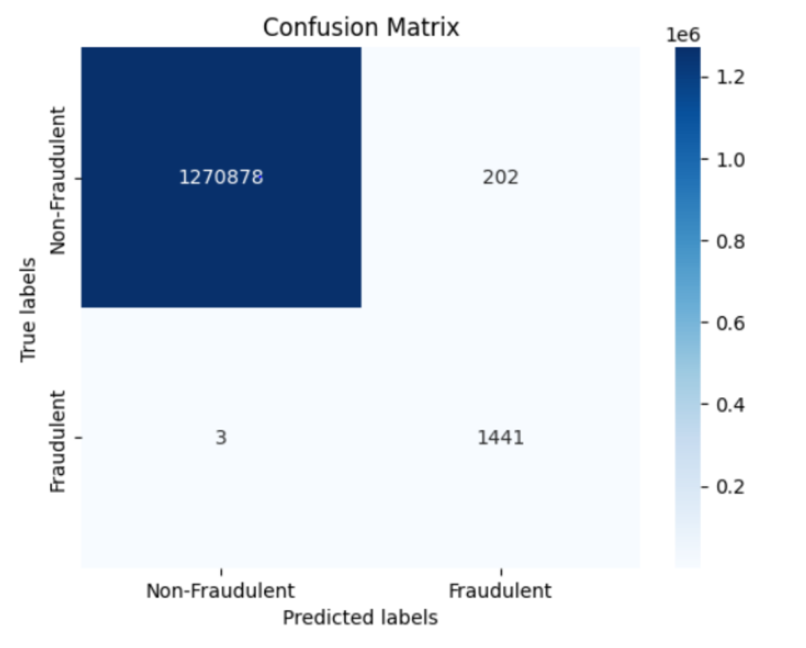
Performance Analysis

Slide 20
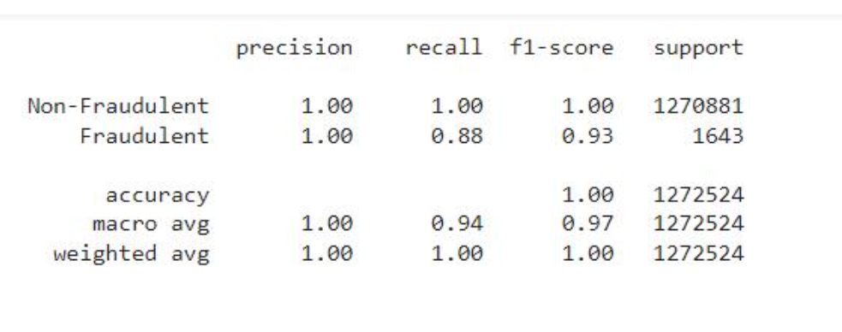
Performance Analysis

Slide 21
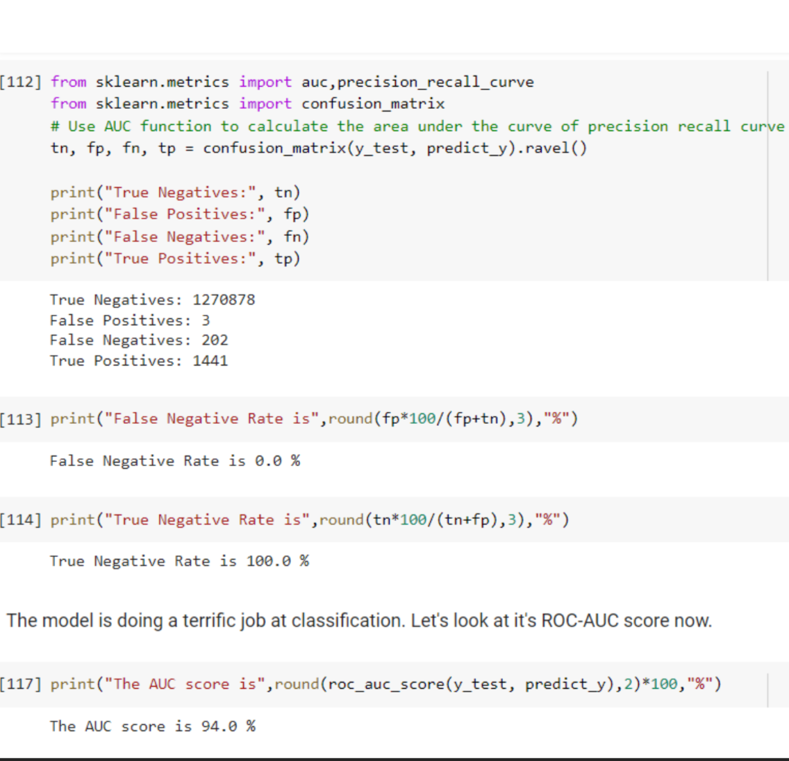
Performance Analysis

Slide 22
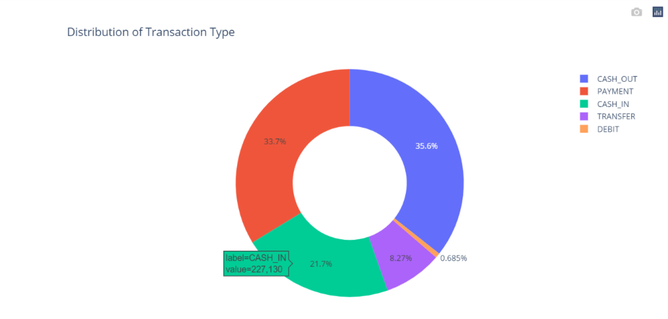
Data Visualization

Slide 23
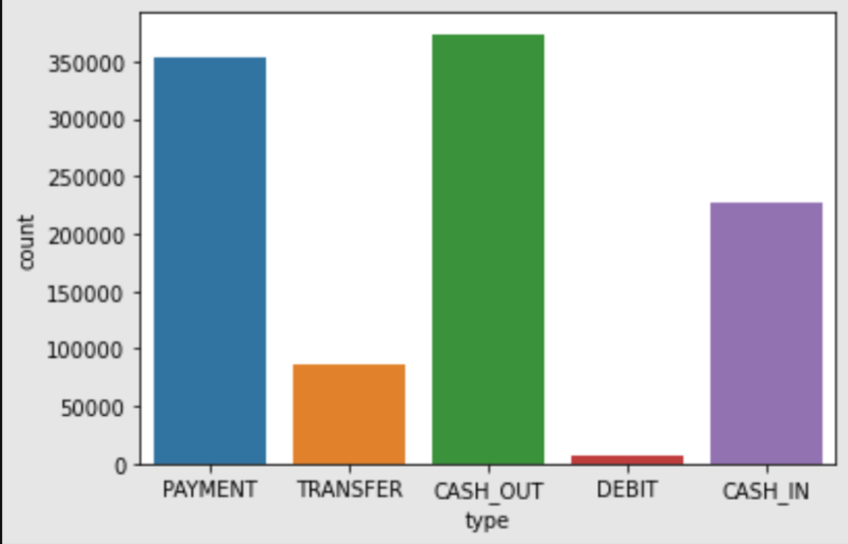
Data Visualization

Slide 24
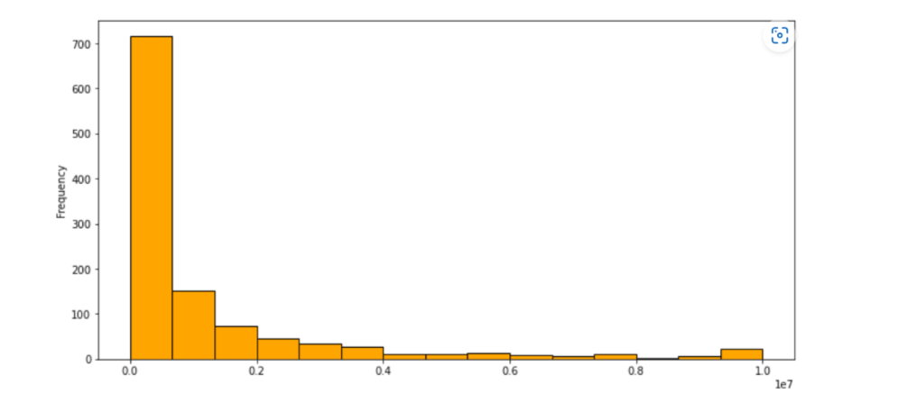
Data Visualization

Slide 25
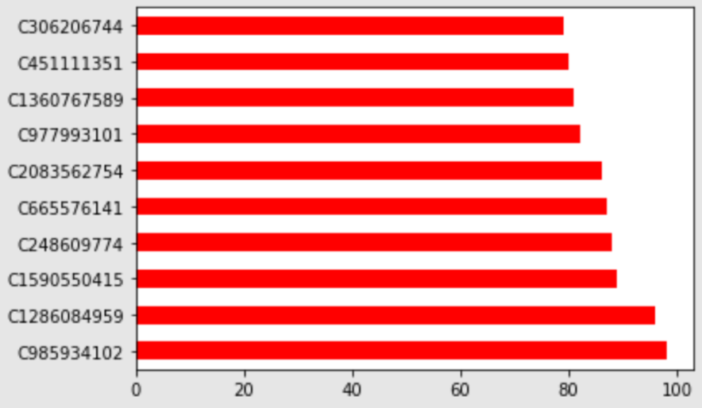
Data Visualization

Slide 26
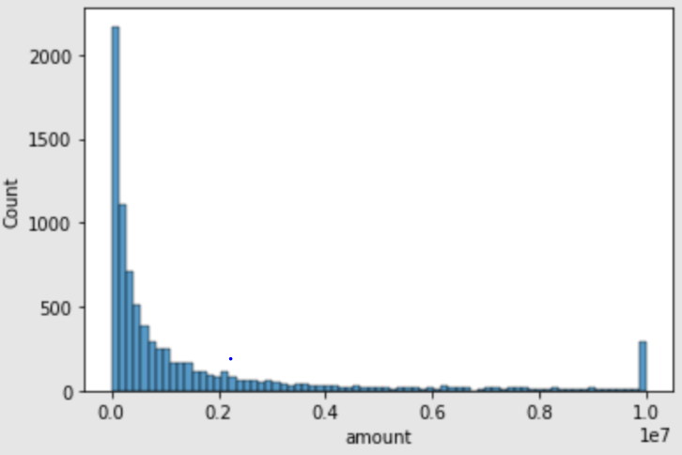
Data Visualization

Slide 27
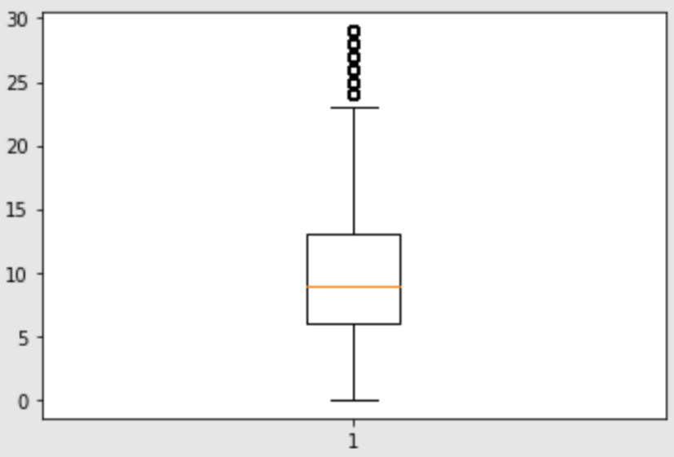
Data Visualization

Slide 28
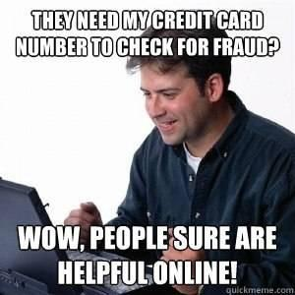
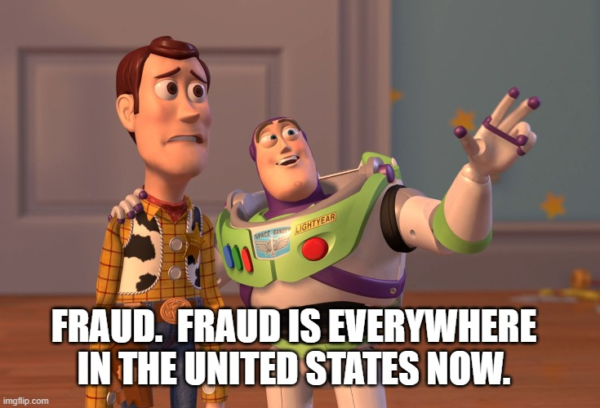

Slide 29
THANK YOU
Team 3
A.J. Miller
Smita Singh
Ajay Kumar Nadimpalli
Krithika Sangareddypeta

